Slide 1
GEOG0114: Principles of spatial analysis
WEEK 5: Suitability mapping (PART 2)
Dr Anwar Musah (a.musah@ucl.ac.uk)
Lecturer in Social and Geographic Data Science
UCL Geography
1

Slide 2
Contents
To understand what are niche models and the concept of niche?
To understand the theoretical framework behind niche modelling
Knowing the modelling process of niche models with specific focus on MAXENT and LOGIT-based regression models
Using the prediction of wildfires in California as a motivating example
Problem
Knowledge
Collect
Model
Wrangle
Explore
2
Notes:
So today we will talk about these items i.e., timetable, assessment…

Slide 3
QUICK recap
Suitability Mapping
Week 4
Week 5
Knowledge-based
(Mixed methods)
Data-driven approach
(Quantitative)
3

Slide 4
Background: What are Niche Models?
4

Slide 5
Definition of Niche Modelling [1]
Niche models are a class of methods that use occurrence data (i.e., an outcome) in conjunction with environmental data (i.e., predictor variables) to make a correlative model of the environmental conditions (or quality and state of the environment) that is tenable for such outcome.
The key focus are as follows:
To geospatially estimate the potential suitability of an area known for an outcome given a set of environmental data
To estimate the geographical limits (or carve out a predicted boundary) for which an outcome can potentially occur (i.e., niches, or suitable area etc.).
Useful making forecasts of potential with future scenarios.
In other words, these are methods that can spatially predict and characterise the relative suitability of areas for where an outcome thrives
Note: In statistical jargon: “Niche modelling” is often referred “Distributional modelling”
5

Slide 6
Definition of Niche Modelling [2]
Niche models are a class of methods that use occurrence data (i.e., an outcome) in conjunction with environmental data (i.e., predictor variables) to make a correlative model of the environmental conditions (or quality and state of the environment) that is tenable for such outcome.
At its core, niche models algorithmically identifies associations between environmental variables and known occurrence of a particular outcome – so as to define conditions within which such outcomes are maintained in geographic space (e.g., animal species, disaster events, crimes etc.)
The use of computer algorithms to:
Then:
First fit:
Generate predictive maps of an outcome showing its ‘niches’ in a form of probability distribution in geographic space using these mathematical function(s)
Mathematical function(s), describing the distribution of an outcome of interest in geographic space for a number for environmental variables
6

Slide 7
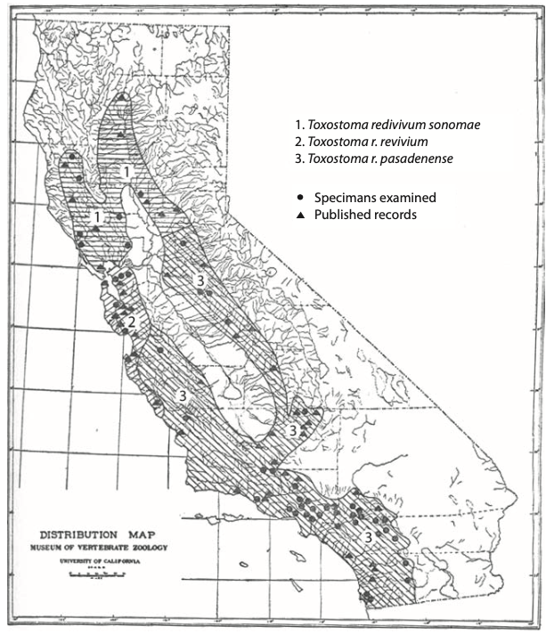
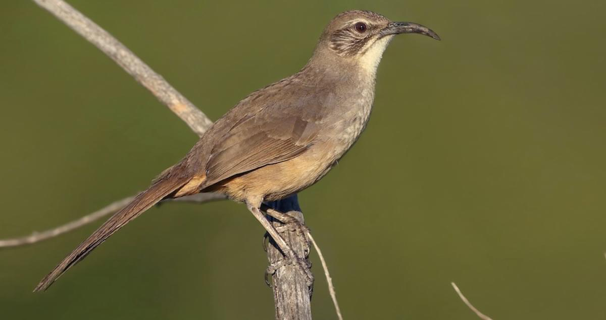
What is the meaning of the word “Niche”?
The ‘Niche’ in modern science describes an area/region where ALL environmental factors influence the fitness of a particular outcome.
The words ‘environmental factors’ has many dimensions in its meaning – this can include physical (e.g., geology, topography, climate etc.), biological, political and/or social environment (e.g., population density, demographic make-up, etc.,)
History of the Niche concept
Joseph Grinnell was the first to offer a comprehensive input to the ideas of niches. From 1904 to 1924, he investigated how variations in environmental conditions were linked to species’ distribution, with special interest on vertebrates. He believed that:
“the existence […] of a species is vitally bound with environments” (Grinnell, 1924, p. 226)
He defined the niche as all factors determining the species’ existence in a given location (i.e., geography) and its interplay with abiotic (i.e., physical environment [e.g., temperature, rainfall etc.,]) and biotic (e.g., food supply, nest sites etc.,) factors as well as movement within such space.
Distribution of 3 different species of the California Thrasher in California. Dots are occurrences of the species, or triangles are published records of sightings. Shade are is the distributional limits of such species. Source: Joseph Grinnell (1917)
7
Notes:
Talk about the origins and how the definition of niche has evolved.
Joseph Grinnell, an American Biologist and Zoologist
Talk about some of the earlier examples of maps predicting the niches of Birds – link it to abiotic, biotic and geographic space.

Slide 8
B-A-M Diagram: Theoretical Framework behind Niche Modelling
G = Geographical space
G = represent the reference of study area
A = Abiotic (Environment)
B = Biotic
B = represent the variation in biologic environmental conditions (resource suitable for species)
A = represent the variation in physical environmental conditions
M = Movement potential within study area
M = Movement
8
Notes:
Is an abstract representation of geographic space
What region in this geography is suitable for the species in terms of conditions and the limits terms of tolerance to things like temperature, precipitation, elevation (things that are physical) – these limits are represented in that blue region of A
A

Slide 9
B-A-M Diagram: Theoretical Framework behind Niche Modelling
G = Geographical space
G = represent the reference of study area
B = represent the variation in biologic environmental conditions (resource suitable for species)
A = Abiotic (Environment)
B = Biotic
A & B
A = represent the variation in physical environmental conditions
M = Movement potential within study area
A & B = This is the interplay between A & B, where they intersect – these are the regions considered to be favourable for species in terms of the conditions from A and B
M = Movement
9
Notes:
Is an abstract representation of geographic space
What region in this geography is suitable for the species in terms of conditions and the limits terms of tolerance to things like temperature, precipitation, elevation (things that are physical) – these limits are represented in that blue region of A

Slide 10
B-A-M Diagram: Theoretical Framework behind Niche Modelling
G = represent the reference of study area
G = Geographical space
B = represent the variation in biologic environmental conditions (resource suitable for species)
A = Abiotic (Environment)
B = Biotic
A = represent the variation in physical environmental conditions
M = Movement potential within study area
A & B & M
A & B & M = This is the interplay between A & B & M, where they intersect – these 3 regions considered to be most optimal for species to live-in in terms of the conditions from A and B and M
M = Movement
This is what we want to estimate in our niche models
10
Notes:
It is this intersection between these three, that we want to model with some niche algorithm.

Slide 11




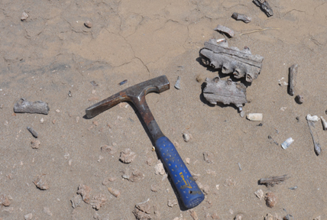
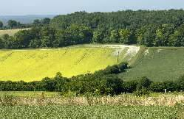
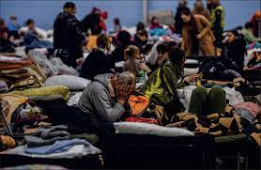
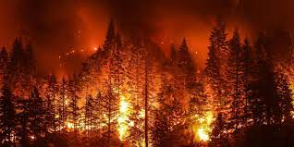
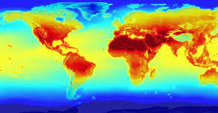
Zoology
Food security
Environmental Criminology
Environmental & Spatial Epidemiology
Vector-borne disease
Palaeontogy and Archology
Landscape ecology
Natural Disaster Science
Climate
Humanitarian crisis
Notes:
Application of niche or distributional models commonly applied to ecologies of animal species (aka Zoology), but it has found its way to other domains, or other realms of research.
Each areas

Slide 12
Zoology
Food security
Environmental Criminology
Environmental & Spatial Epidemiology
Vector-borne disease
Palaeontogy and Archology
Landscape ecology
Natural Disaster Science
Climate
Humanitarian crisis

Slide 13
Example of application to quantitative criminology
B-A-M Diagram: Crime Pattern Theory
G = Activity space for potential offender
G = represent the reference of study area
B = Target refers to the victim (person, house, shop etc.)
A = Environment
B = Target
A = represent the variation in physical environmental conditions – environmental factors that attract a potential offender (security, social disorganisation etc.)
A & B & M
Crime event
M = Movement potential within study area (street network; accessibility etc.)
A & B & M = This is the interplay between A & B & M, where they intersect – these 3 regions considered to be most optimal for crimes to occur in terms of when conditions from A and B and M converge
M = Movement (Awareness)
This is what we want to estimate in our models
13
Notes:
Crime pattern theory provides a framework for the scientific understanding of criminal events in space and time at many levels of analysis.
Crime pattern theory claims that a crime involving an offender and a victim or target can only occur when the activity spaces of both cross paths. Simply put crime will occur if an area provides the opportunity for crime and it exists within an offender's awareness space.
It is possible to adapt this criminological framework to B-A-M diagram.

Slide 14
What is the methodology behind niche models?
14

Slide 15
Modelling process [1]
Things to consider:
Definition of the research question
Data identification and preparation (i.e., environmental layers, presence only vs presence & absence data (from surveys), or random generation of background data (to act as “pseudo absences”)
Selection of a modelling algorithm
Statistical inference and testing predictive performance (i.e., examine of variable contribution, response curves for each predictor variable and Area Under the Curve (AUCs))
Interpretation of model outputs (i.e., predicted probabilities and suitability areas/niches)
15

Slide 16
Modelling process [2]
Definition of the research question
The research question, in whatever context or domain of science it is in. You must be able to link whatever scientific theory (or plausible mechanism) that explains the outcome of interest with the BAM diagram.
Ask yourself the following questions:
What is the outcome of interest?
What are the environmental (i.e., abiotic and biotic) factors that influence the occurrence of an outcome?
Is there a scientific explanation or plausible mechanism?
This is how you justify the use of niche models to addressing research question.
16

Slide 17
Modelling process [2]
Data identification and preparation
Environmental variables: these are a series of gridded raster datasets
Outcome of interest: This is spatial point data only; it should represent the presence of an outcome. There are three types of formats – which they can be presented.
Presence-only: This refers to point sample locations with information on known presence of a particular outcome. But at the same time, does not contain point sample location of known absences of that outcome.
Presence and absence: This refers to point sample locations with information on known presence and absence of a particular outcome.
Presence and pseudo-absence: This refers to point sample locations with information on known presence of a particular outcome only. But the absence points were generated at random spatially to be used as controls.
17

Slide 18
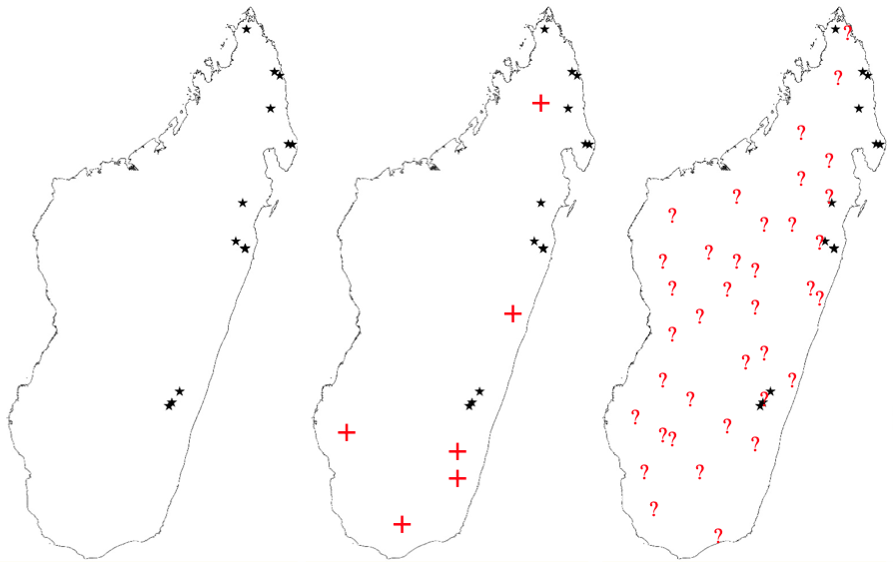
Example: Malaria prevalence survey in Madagascar
Research question: Where will Malaria transmission occur?
Presence only: Surveys of communities with at least one person infected with Malaria
Presence & absence: Surveys of communities where we have at least one infected person with Malaria at a location; a community with people disease free.
Presence and pseudo-absence: We only surveys of communities with at least one person infected with Malaria. No absence data, and hence we generate them randomly to act as proxies for absences (background)
18

Slide 19
Modelling process [3]
Selection of a modelling algorithm
Niche Models | Data type
Climatic envelope Gower Metric | Presence-only
Maximum entropy (MAXENT) | Presence and pseudo-absence (background)
Regression-based models: e.g., Generalised linear model (GLM) and Generalised additive model (GAM)(non-linear) | Presence and absence Presence and pseudo-absence (background)
Machine learning models: Artificial Neural Network (ANN); Classification and regression-trees for GLM, GAM and ANNs | Presence and absence
There are a tonne of other models out there which I have not listed
because I just don’t know what they do…
19

Slide 20
Modelling process [3]
Selection of a modelling algorithm
Niche Models | Data type
Climatic envelope Gower Metric | Presence-only
Maximum entropy (MAXENT) | Presence and pseudo-absence (background)
Regression-based models: e.g., Generalised linear model (GLM) and Generalised additive model (GAM)(non-linear) | Presence and absence Presence and pseudo-absence (background)
Machine learning models: Artificial Neural Network (ANN); Classification and regression-trees for GLM, GAM and ANNs | Presence and absence
There are a tonne of other models out there which I have not listed
because I just don’t know what they do…
20

Slide 21
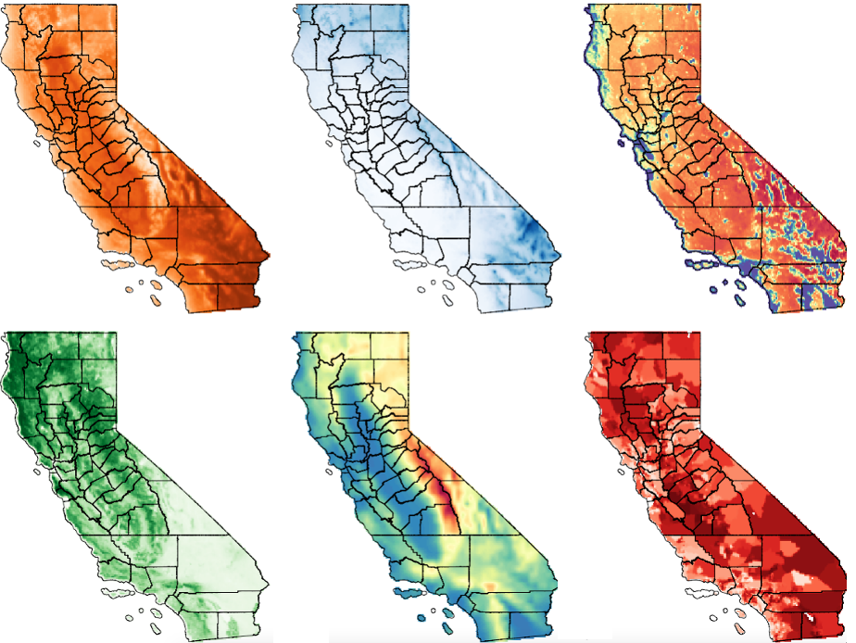
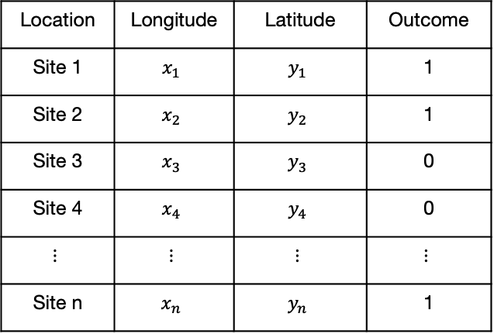
Modelling process [3]
Selection of a modelling algorithm
Niche Models | Data type
Maximum entropy (MAXENT) | Presence and pseudo-absence (background)
Regression-based models: e.g., Generalised linear model (GLM) and Generalised additive model (GAM)(non-linear) | Presence and absence
Occurrence point data
Environmental data (multi-band raster)
Location | Longitude | Latitude | Outcome
Site 1 | $$x_{1}$$ | $$y_{1}$$ | 1
Site 2 | $$x_{2}$$ | $$y_{2}$$ | 1
Site 3 | $$x_{3}$$ | $$y_{3}$$ | 0
Site 4 | $$x_{4}$$ | $$y_{4}$$ | 0
$$⋮$$ | $$⋮$$ | $$⋮$$ | $$⋮$$
Site n | $$x_{n}$$ | $$y_{n}$$ | 1
Raster-to-point
extraction
21

Slide 22
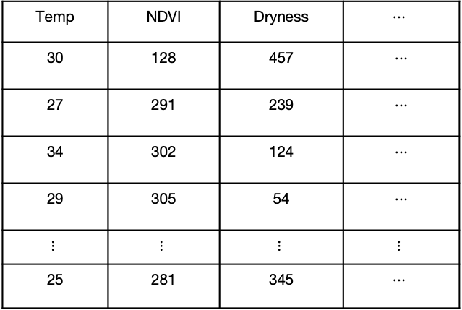
Modelling process [3]
Selection of a modelling algorithm
Niche Models | Data type
Maximum entropy (MAXENT) | Presence and pseudo-absence (background)
Regression-based models: e.g., Generalised linear model (GLM) and Generalised additive model (GAM)(non-linear) | Presence and absence
Linked occurrence point data with environmental data
Extracted environmental values from Rasters
Location | Longitude | Latitude | Outcome
Site 1 | $$x_{1}$$ | $$y_{1}$$ | 1
Site 2 | $$x_{2}$$ | $$y_{2}$$ | 1
Site 3 | $$x_{3}$$ | $$y_{3}$$ | 0
Site 4 | $$x_{4}$$ | $$y_{4}$$ | 0
$$⋮$$ | $$⋮$$ | $$⋮$$ | $$⋮$$
Site n | $$x_{n}$$ | $$y_{n}$$ | 1
Temp | NDVI | Dryness | $$⋯$$
30 | 128 | 457 | $$⋯$$
27 | 291 | 239 | $$⋯$$
34 | 302 | 124 | $$⋯$$
29 | 305 | 54 | $$⋯$$
$$⋮$$ | $$⋮$$ | $$⋮$$ | $$⋮$$
25 | 281 | 345 | $$⋯$$
22

Slide 23
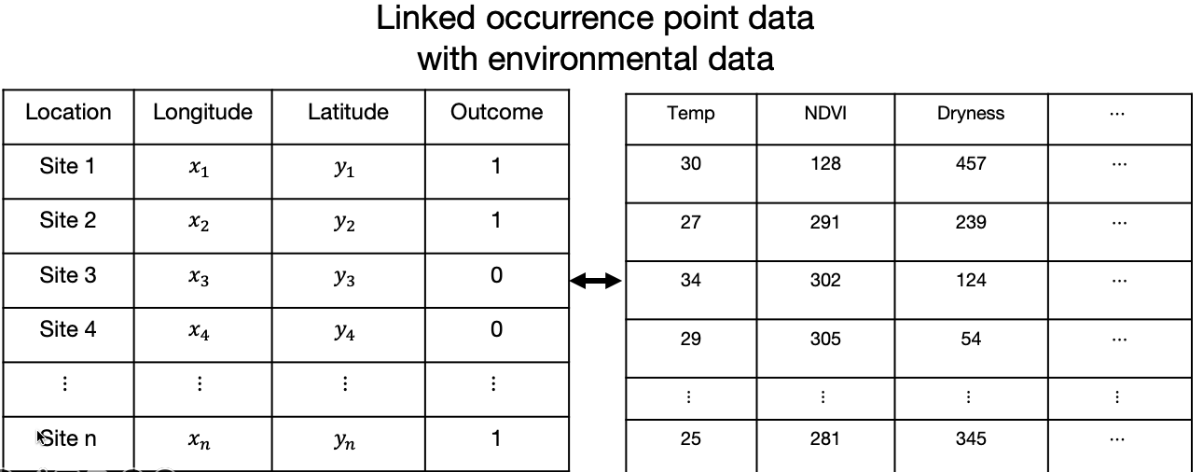
Modelling process [4]
Statistical inference and testing predictive performance
We use the linked point data and split this according for k-fold cross-validation:
Testing (20%) | Training (80%) (5 equal portion (1 selected for testing))
Testing (25%) | Training (75%) (4 equal portion (1 selected for testing))
Training data: Is the large portion of records we use for the actual prediction – this creates our trained model
Testing data: Is the small portion of records we use to assess the predictive performance of our trained model.
Evaluation of testing data, we are interested in two outputs which measures for model accuracy:
Area Under a Curve (threshold for good model: 0.5)
Optimized estimate or thresholds for where predictions are a true positive and true negative [max TPR+TNR]
If the overall AUC > 0.5, proceed to use the trained model on multi-band raster generate probability estimates across region
Use optimized estimate threshold from [max TPR+TNR] to map the extent for suitability for the outcome.
>>
23

Slide 24
The Beginning: Introduction to Spatial Analysis and Data Science
Example: Predicting the extent of wildfires in California
24

Slide 25
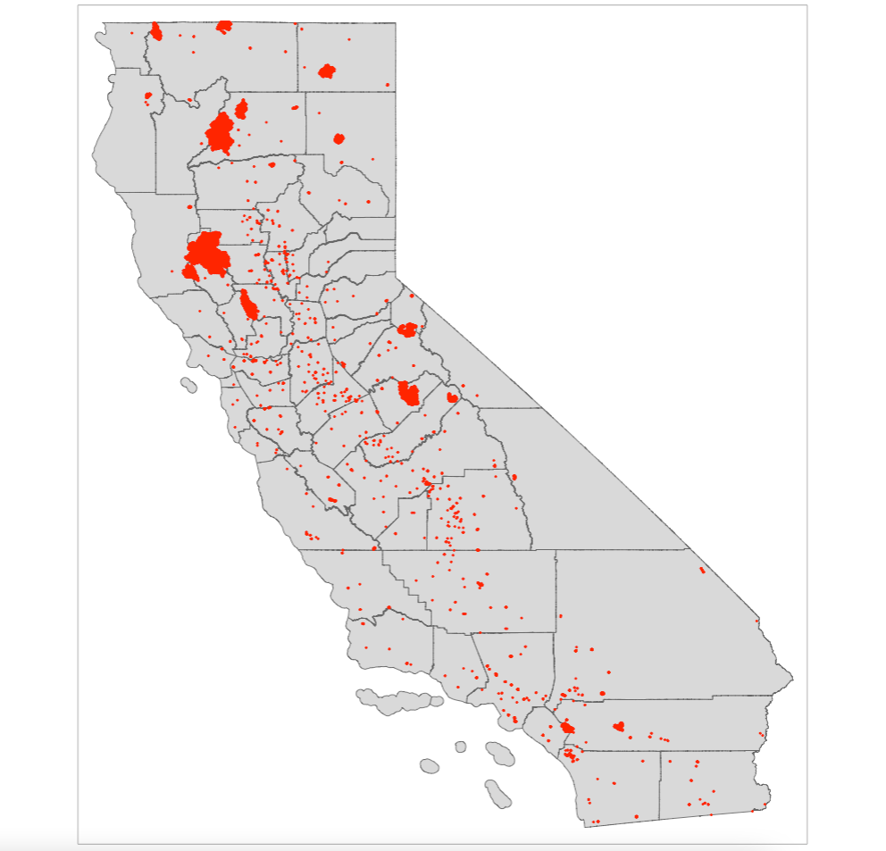
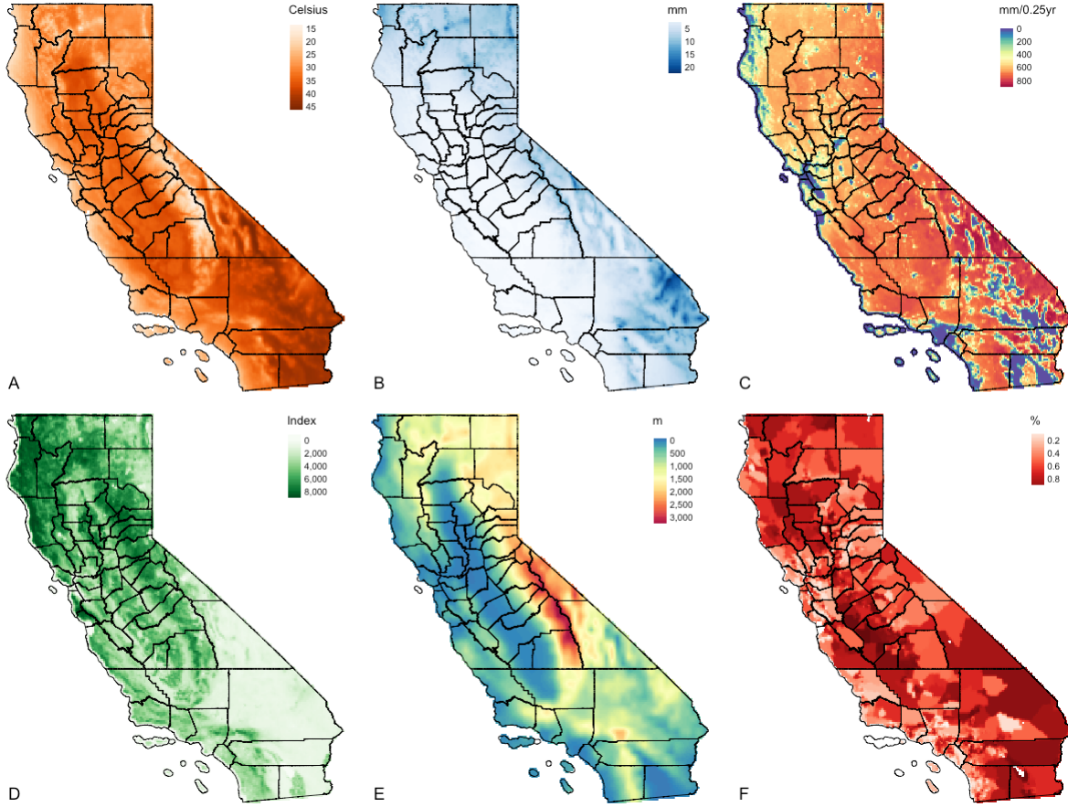
Taylor, L. (2022):
The social side of fires: assessing the inclusion of human social factors in fire prediction models
The objectives are to determine the occurrence of wildfires, as well as infer the extent (or zones) for such environmental hazard in California given a set of predictor variables (i.e., climate, vegetation, anthropogenic and socioeconomic risk factors which are raster)
Figure shows the study area of California (counties) and points are occurrence of wildfires during the summer period of 2018. Presence-only points.
Figure panel shows A: Temperature (degree Celsius); B: Precipitation (mm); C: Dryness (Evapotranspiration) (mm/0.25 year); D: Vegetation (NDVI); E: Elevation (meters [m]); & F: Socioeconomic vulnerability index (%)
25

Slide 26
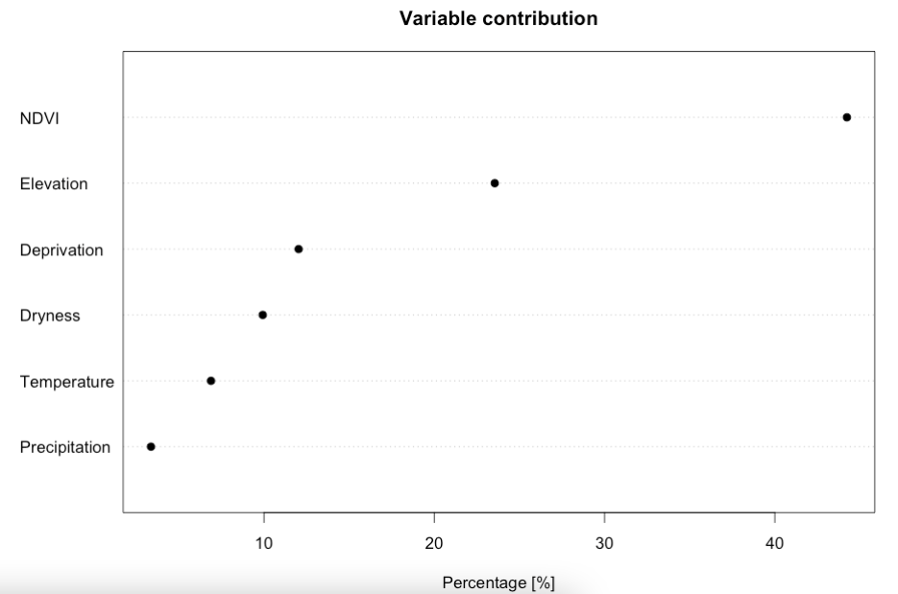
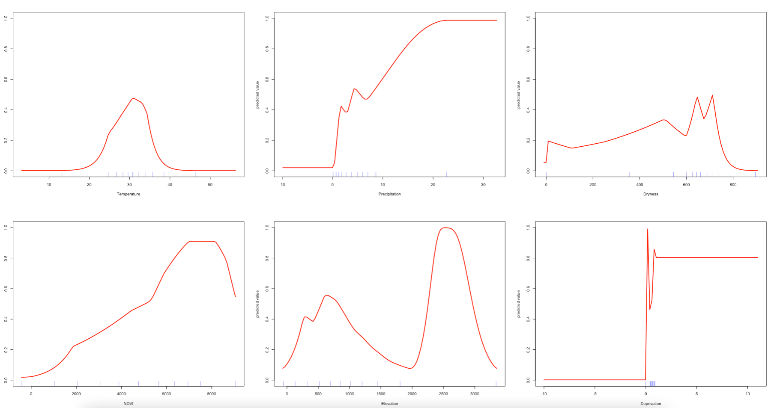
Using MAXENT
Result 1: Variable Contribution & Response curves
Response curves
Interpretation: Here, we can see the following contribution estimates: NDVI (44.2321%); Elevation (23.5530%); Deprivation (12.0339%); Dryness (9.9266); Temperature (6.8892%); and Precipitation (3.3653%). The contribution estimates should sum up to 100%. From this plot, we can see that the model is most sensitive to variation in NDVI, followed with additional contributions from land surface elevation, and from increased levels of socioeconomic deprivation (reporting top three).
Figure panel shows from top left: Temperature (degree Celsius); Precipitation (mm); Dryness (Evapotranspiration) (mm/0.25 year); Vegetation (NDVI); Elevation (meters [m]); & Socioeconomic vulnerability index (%)
Interpretation: In the response plots, we are looking at how the probability of fire occurrence (Y-axes, from zero to one) varies with each the environmental predictors (X-axes). From these plots, we can see that the MAXENT models can include complex environmental responses including plateau, linear, and nonlinear shapes, and some which are utterly unclear. For example, if we look at mean temperature during the summer, we can see that the probability for fire occurrence peaks around 0.60 when temperatures are around 30 degrees Celsius. We can also see that the probability of such outcome increases with more and more vegetation during the summer period. Probability in terms of fires in relation to deprivation is a flat line. For precipitation, dryness and elevation - the patterns are unclear.
26

Slide 27
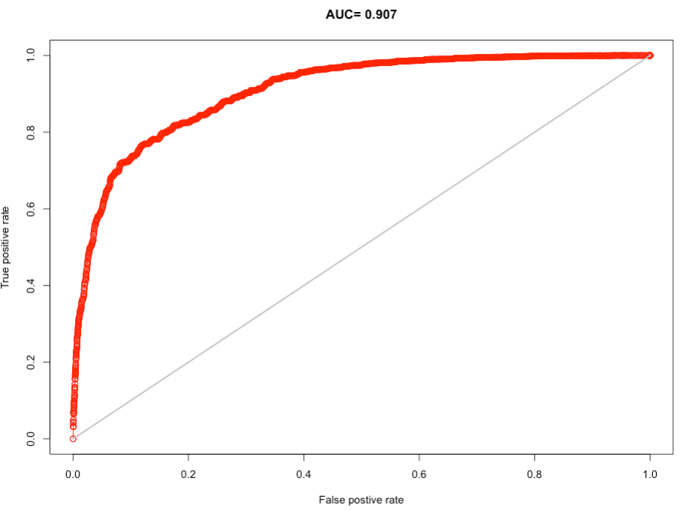
Using MAXENT
Result 2: Model validation
Interpretation: On the receiver operator curve (ROC), the 1:1 line give an AUC of 0.5. From our curve and the AUC, it is clear that our model appears to do substantially better than random guessing (high AUC value = 0.907 [90.7%] > 0.5).
The optimal probability threshold at which our model maximizes the True Positive Rate and the True Negative Rate is 0.4054474 (40.55%). Hence, we will use predicted probability > 0.4054 to delineate areas of suitability (or trigger points) for wildfires.
27

Slide 28
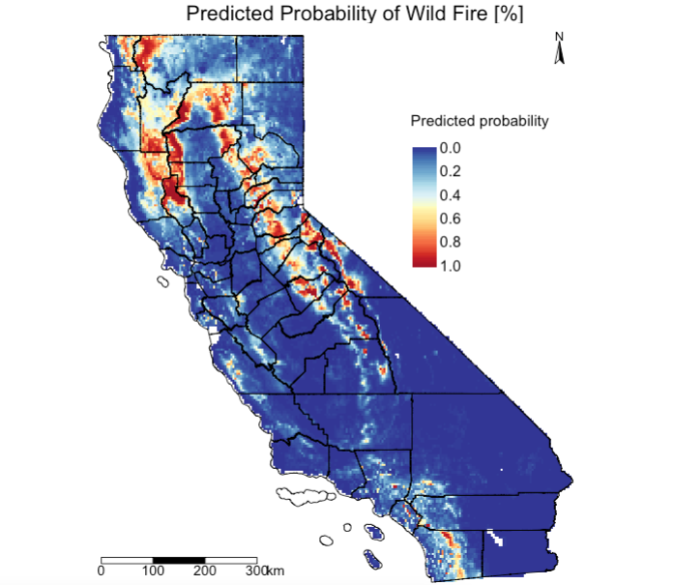
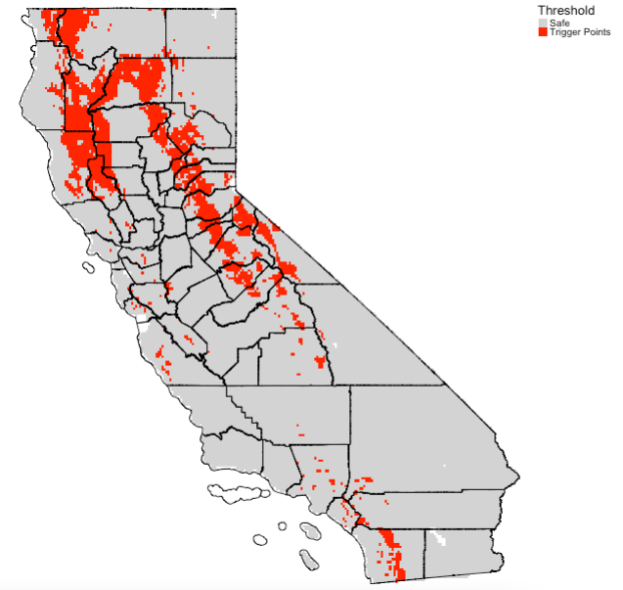
Using MAXENT
Result 3: Predicted probability of fire occurrence & areas for
environmental suitability for fire hazards (i.e., trigger points)
We mapped predicted probability of fires using the trained model after making sure its valid. The multi-band raster is fed to the trained model to make full scale predictions.
This is based on the optimized estimate obtained after model validation i.e., maximizes the True Positive Rate and the True Negative Rate is 0.4054474 (40.55%). Here, we mapped predicted probability > 0.4054 as a reclassified raster.
28

Slide 29
Any questions?
29

